Slide 1

IBM Capstone Project
Tushar Desale
12/07/2025

Slide 2



OUTLINE
Executive Summary
Introduction
Methodology
Results
Visualization – Charts
Dashboard
Discussion
Findings & Implications
Conclusion
Appendix

Slide 3

EXECUTIVE SUMMARY
The IT workforce is undergoing rapid transformation, driven by evolving programming languages, database preferences, and automation tools.
This study delves into industry shifts, focusing on the adaptability required to keep pace with emerging technologies.
Career longevity in IT is a growing challenge, as the field sees a steep decline in professionals over 30, highlighting retention issues.
Despite increased awareness, gender diversity remains a significant gap in the industry, calling for structural changes in hiring and education.

Slide 4

INTRODUCTION
The IT industry is rapidly evolving, requiring professionals to adapt to new technologies and tools.
This study examines key aspects of the IT workforce, including technology usage, future trends, and demographic shifts.
Understanding programming language and database trends helps professionals and organizations stay competitive in the industry.
The research is based on data-driven insights gathered from multiple sources to ensure accuracy and relevance.

Slide 5

METHODOLOGY
Data was collected from multiple sources, including web scraping, provided datasets, and online courses.
The analysis focused on key areas such as current technology usage, future trends, and workforce demographics.
Various visualization techniques, including graphs, dashboards, and charts, were used to present the findings effectively.
The data was cleaned, processed, and analyzed using statistical and analytical tools to ensure accuracy and relevance.

Slide 6
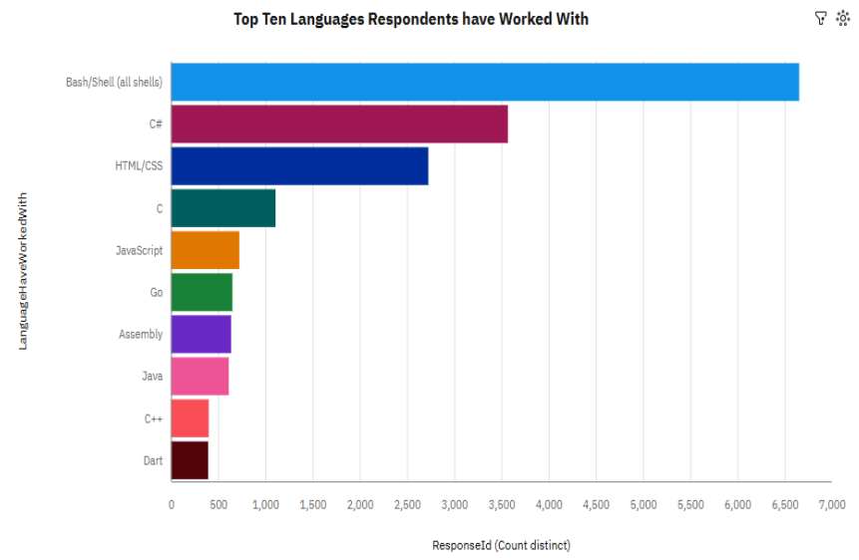
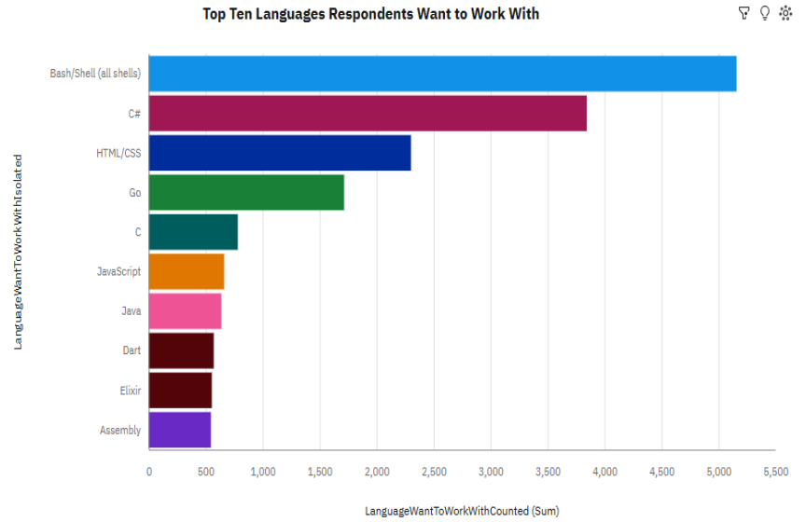
PROGRAMMING LANGUAGE TRENDS
Current Year
Next Year

Slide 7
PROGRAMMING LANGUAGE TRENDS - FINDINGS & IMPLICATIONS
Findings
Scripting languages like Bash/Shell continue to be widely used, showing the importance of automation in IT operations.
The demand for frontend technologies (HTML/CSS) and backend languages (C#) indicates a balanced need for full-stack development skills.
Older languages like Assembly are still in use, proving that legacy systems remain relevant despite newer programming innovations.
Implications
Automation skills are becoming essential, meaning IT professionals should prioritize learning scripting languages for efficiency.
The continued relevance of both frontend and backend languages highlights the growing need for well-rounded developers who can work across different layers of applications.
Legacy programming knowledge remains valuable, so professionals should maintain expertise in older languages for maintaining and upgrading existing systems.

Slide 8
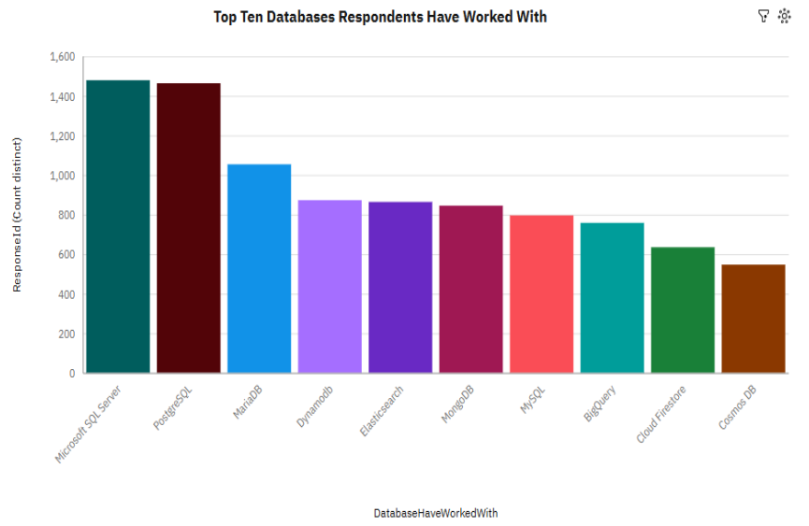
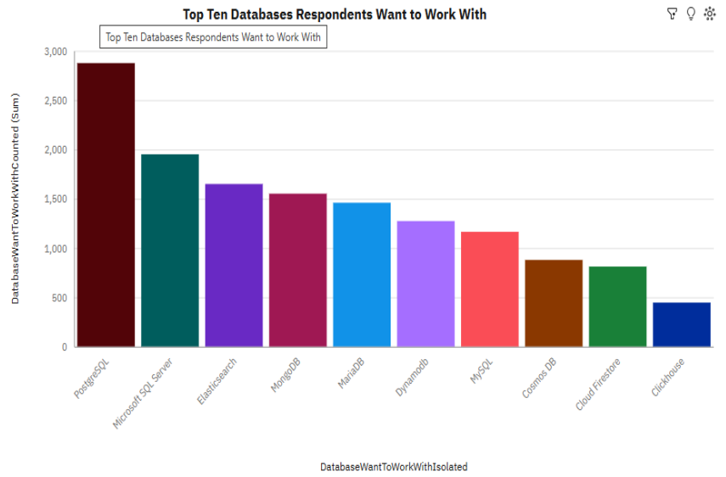
DATABASE TRENDS
Current Year
Next Year

Slide 9
DATABASE TRENDS - FINDINGS & IMPLICATIONS
Findings
The chart shows that these two databases SQL, Server & PostgreSQL dominance are the most used.
The usage of other databases is relatively evenly distributed, with no single dominant alternative.
PostgreSQL is the most desired database for learning, surpassing other databases.
Implications
Organizations should focus on PostgreSQL and Microsoft SQL Server training, as they remain industry standards.
The increasing interest in PostgreSQL suggests a shift toward open-source, scalable database solutions over proprietary alternatives.
IT professionals need to stay adaptable and gain expertise in multiple databases to remain competitive in the job market.

Slide 10

DASHBOARD
Dashboard Tab 1: Current Technology Usage
Dashboard Tab 2: Future Technology Trend
Dashboard Tab 3: Demographics

Slide 11
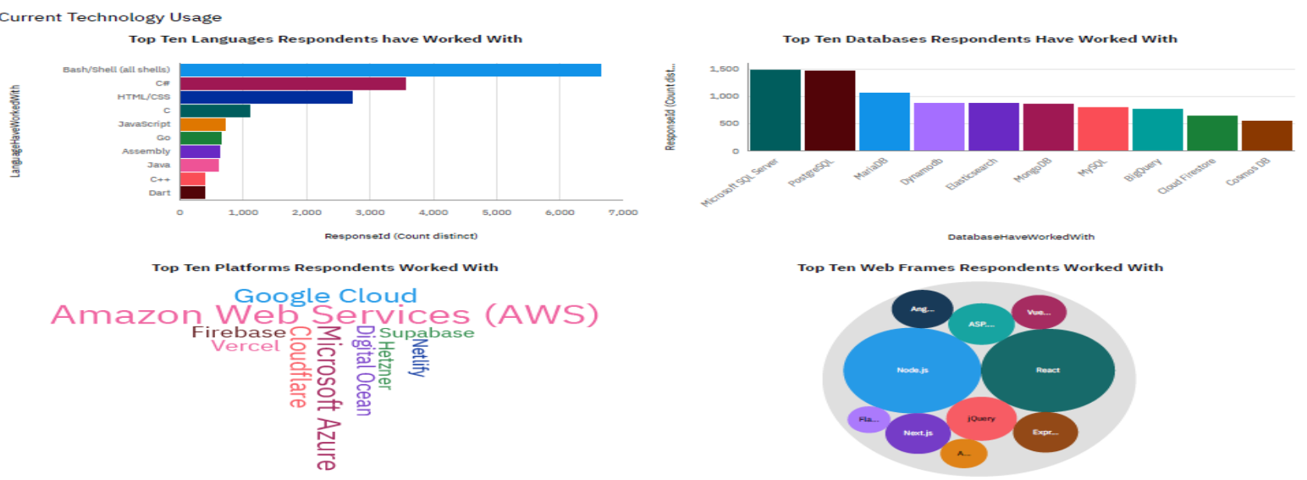
DASHBOARD TAB 1

Slide 12
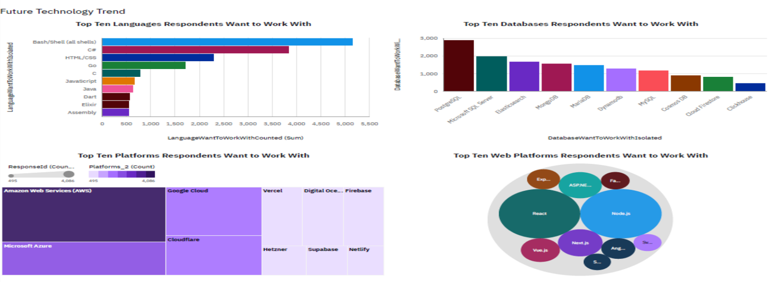
DASHBOARD TAB 2

Slide 13
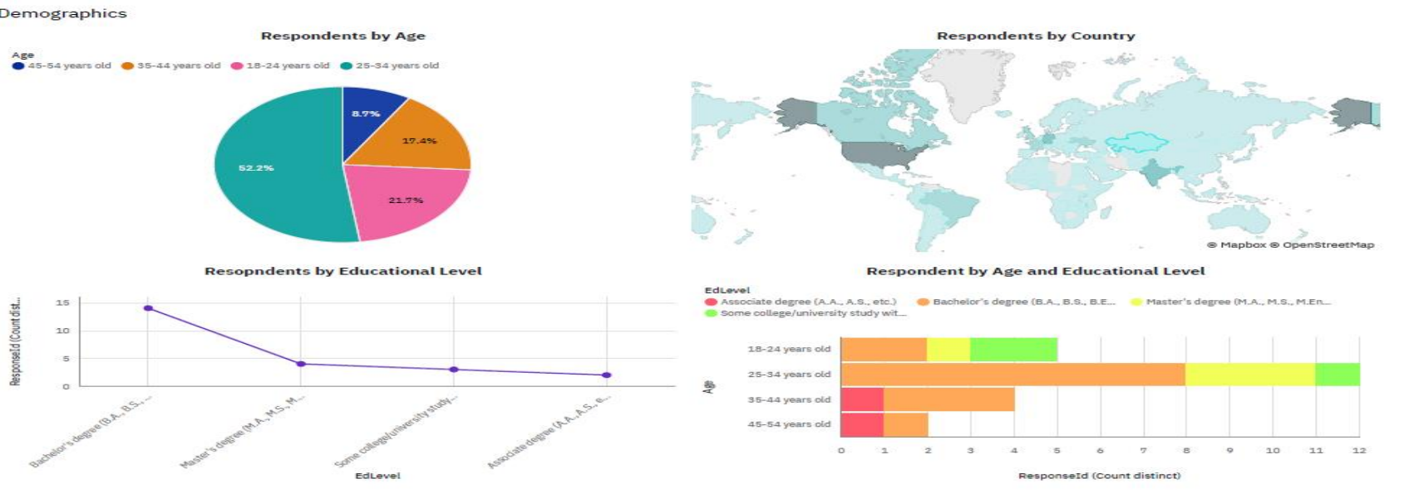
DASHBOARD TAB 3

Slide 14
DISCUSSION
Cloud computing and AI-driven development are reshaping the skills required for IT professionals.
Employers must invest in training programs to keep their workforce competitive in a rapidly evolving industry.
The underrepresentation of women in IT highlights the need for stronger diversity initiatives.
The increasing popularity of PostgreSQL suggests a shift toward open-source database solutions.

Slide 15
OVERALL FINDINGS & IMPLICATIONS
Findings
The IT workforce is predominantly young, with numbers declining after age 30.
AI is transforming the IT industry by simplifying coding and automation.
The popularity of programming languages and databases shifts frequently.
Implications
Companies must implement retention strategies and continuous learning opportunities to maintain experienced professionals.
IT professionals need to adopt AI-driven tools to enhance efficiency and remain competitive in the evolving job market.
Professionals must stay adaptable and continuously update their technical skills to align with industry trends.

Slide 16

CONCLUSION
Scripting languages, particularly Bash, remain essential in IT, indicating that automation and lightweight scripting continue to be in high demand.
Despite the variety of available databases, PostgreSQL is the most desired for learning, suggesting a shift toward open-source, scalable database solutions.
AI-driven tools are being adopted at an increasing rate, showing a growing trend where professionals rely on AI to enhance productivity and simplify complex coding tasks.
The IT workforce exhibits a high level of educational attainment, with most professionals holding at least a bachelor’s degree, reinforcing the importance of formal education in securing IT roles.

Slide 17

APPENDIX
Include any relevant additional charts, or tables that you may have created during the analysis phase.

Slide 18
JOB POSTINGS
In Module 1 you have collected the job posting data using Job API in a file named “job-postings.xlsx”. Present that data using a bar chart here. Order the bar chart in the descending order of the number of job postings.

Slide 19
POPULAR LANGUAGES
In Module 1 you have collected the job postings data using web scraping in a file named “popular-languages.csv”. Present that data using a bar chart here. Order the bar chart in the descending order of salary.

